Slide 1
EE 616
Computer Aided Analysis of Electronic Networks
Lecture 3
Instructor: Dr. J. A. Starzyk, Professor
School of EECS
Ohio University
Athens, OH, 45701
09/12/2007

Slide 2
Review and Outline
Review of the previous lecture
* Network scaling
* Thevenin/Norton Analysis
* KCL, KVL, branch equations
* Sparse Tableau Analysis (STA)
* Nodal analysis
* Modified nodal analysis
Outline of this lecture
* Network Equations and Their Solution
-- Gaussian elimination
-- LU decomposition(Doolittle and Crout algorithm)
-- Pivoting
-- Detecting ILL Conditioning

Slide 3
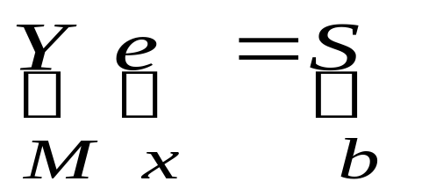
Problems:
A is n x n real non-singular
X is nx1;
B is nx1;
Direct methods: find the exact solution in a finite number of steps
-- Gaussian elimination, LU decomposition, Crout, Doolittle)
Iterative methods: produce a sequence of approximate solutions hopefully converging to the exact solution
-- Gauss-Jacobi, Gauss-Seidel, Successive Over Relaxation (SOR)

Slide 4
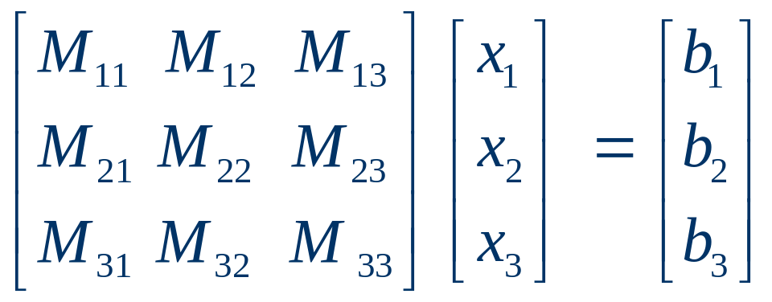
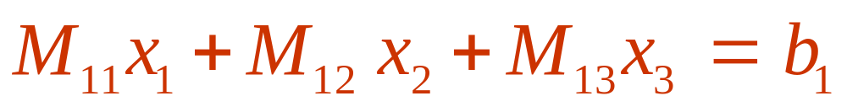
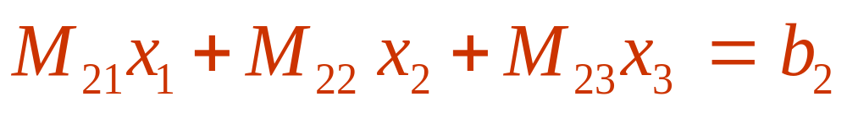

Gaussian Elimination Basics
Reminder by 3x3 example

Slide 5
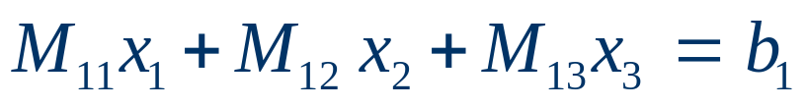
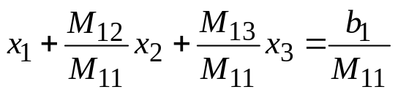
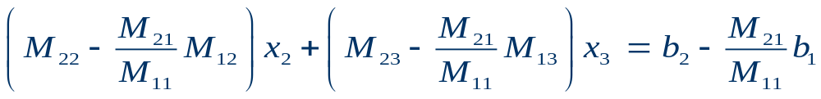

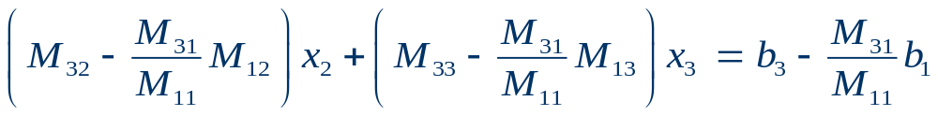
Gaussian Elimination Basics – Key idea
Use Eqn 1 to Eliminate x₁ from Eqn 2 and 3
Eq.1 divided by M11
(*)
Multiply equation (*) by –M21 and add to eq (2)
Multiply equation (*) by –M31 and add to eq (3)

Slide 6
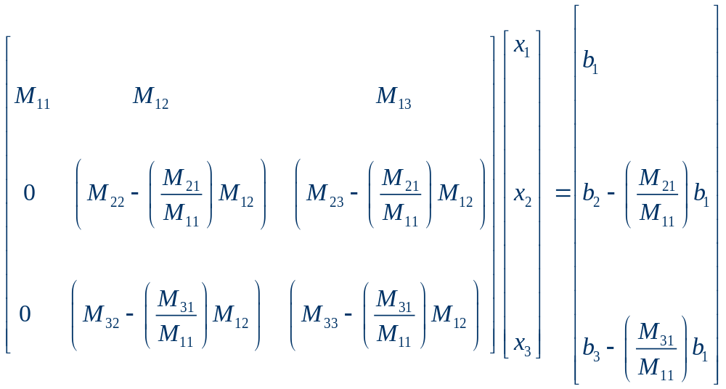
GE Basics – Key idea in the matrix
Pivot

Slide 7
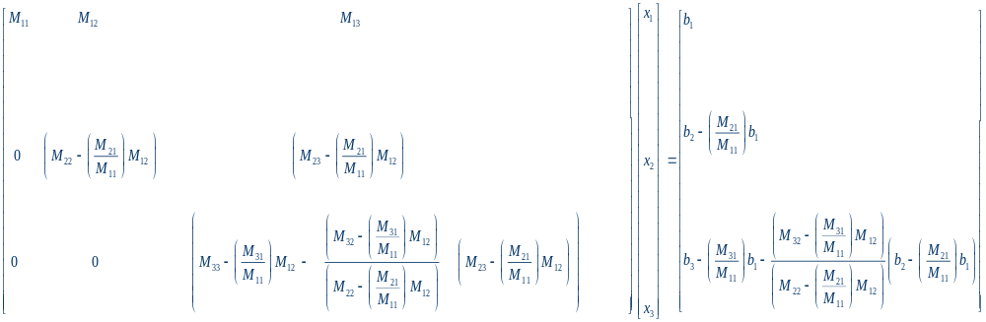
GE Basics – Key idea in the matrix
Continue this step to remove x2 from eqn 3

Slide 8
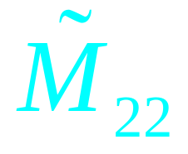
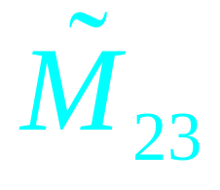

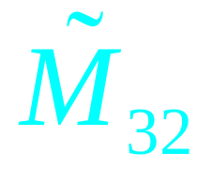


GE Basics – Simplify the notation
Remove x1 from eqn 2 and eqn 3
Notes:
08/24/15

Slide 9
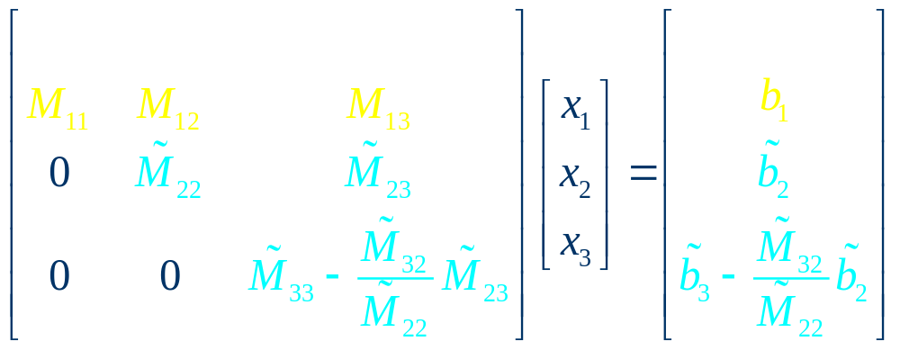
GE Basics – Simplify the notation
Remove x2 from eqn 3
Notes:
08/24/15

Slide 10
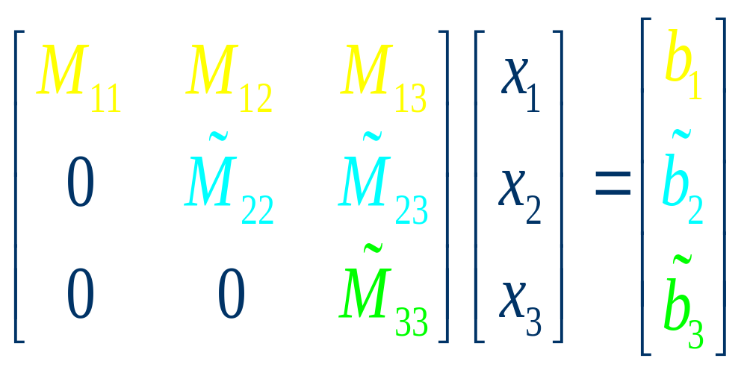
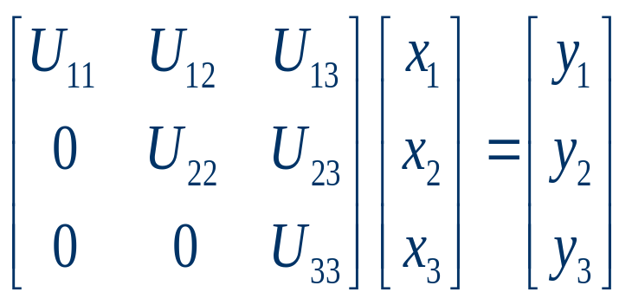
GE Basics – GE yields triangular system
Altered
During
GE
~
~
Notes:
08/24/15

Slide 11
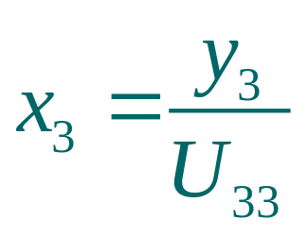
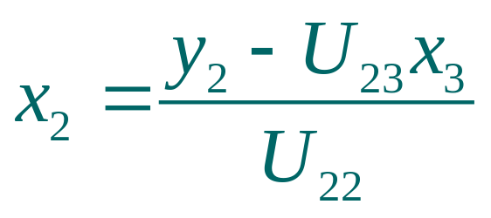
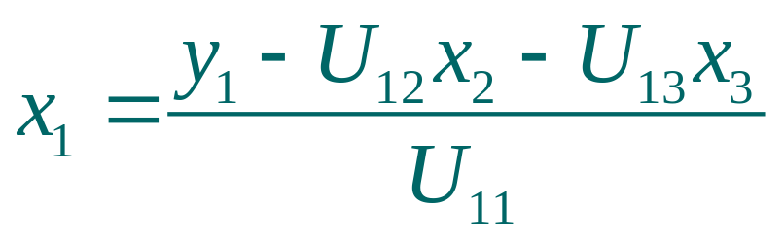
GE Basics – Backward substitution
Notes:
08/24/15

Slide 12
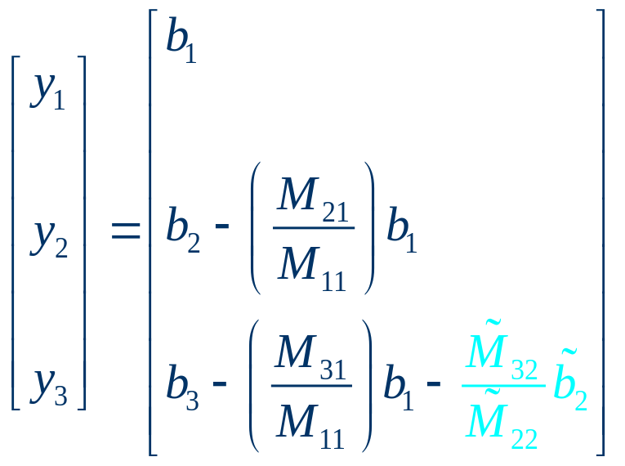
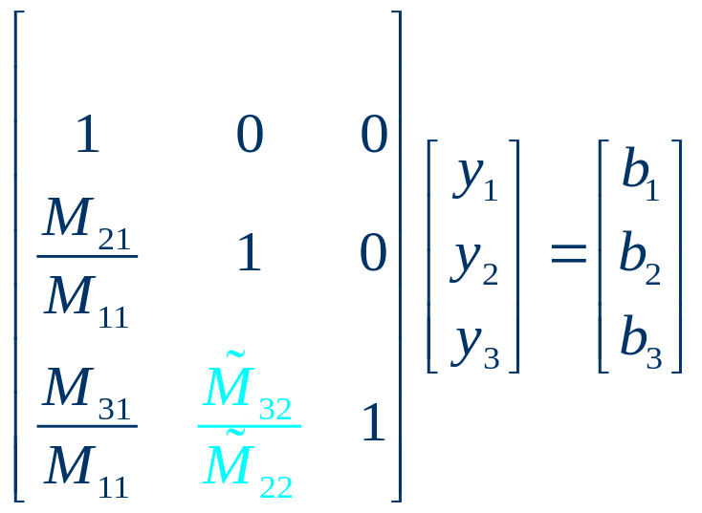
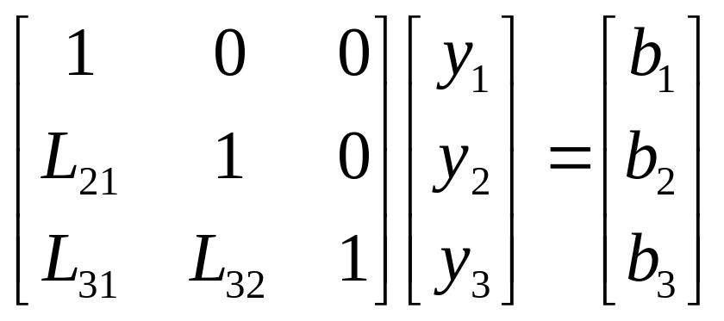
GE Basics – RHS updates
Notes:
08/24/15

Slide 13
GE basics: summary
(1) M x = b
U x = y Equivalent system
U: upper triangle
(2) Noticed that:
Ly = b L: unit lower triangle
U x = y
LU x = b → M x = b
GE
⇒ Efficient way of implementing GE: LU factorization

Slide 14
Gaussian Elimination Basics
Solve M x = b
Step 1
Step 2 Forward Elimination
Solve L y = b
Step 3 Backward Substitution
Solve U x = y
M = L U
=
Note: Changing RHS does not imply to recompute LU factorization
Notes:
08/24/15
Recall from basic linear algebra that a matrix A can be factored into the product of a lower and an upper triangular matrix using Gaussian Elimination. The basic idea of Gaussian elimination is to use equation one to eliminate x1 from all but the first equation. Then equation two is used to eliminate x2 from all but the second equation. This procedure continues, reducing the system to upper triangular form as well as modifying the right-hand side. More is
needed here on the basics of Gaussian elimination.

Slide 15
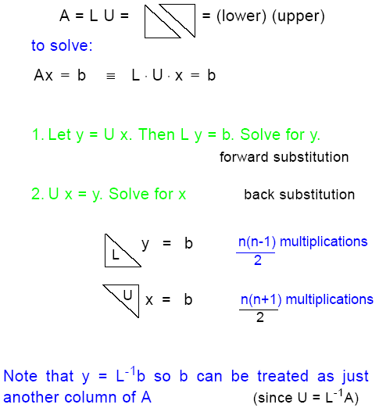
LU decomposition

Slide 16
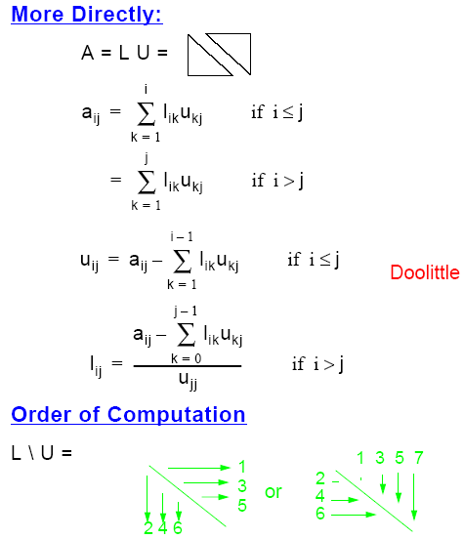
LU decomposition

Slide 17
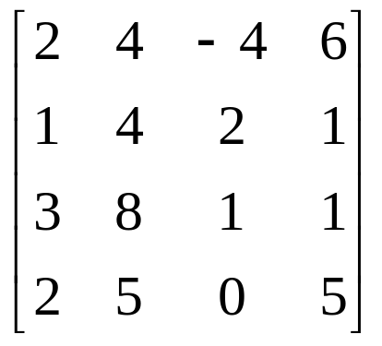
LU decomposition – Doolittle example

Slide 18
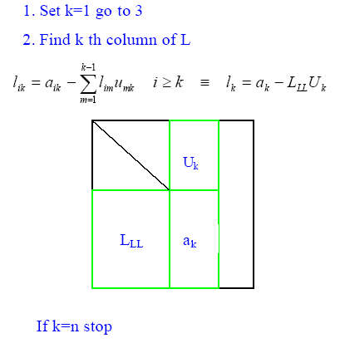
LU factorization (Crout algorithm)

Slide 19
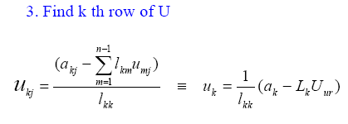
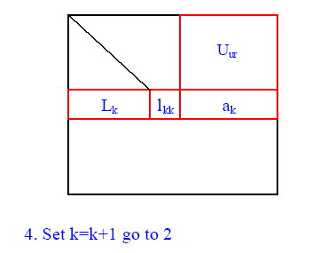
LU factorization (Crout algorithm)

Slide 20
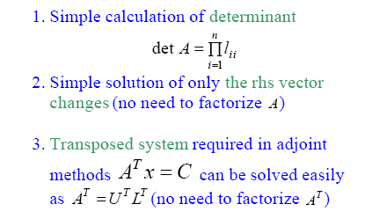
Properties of LU factorization
Now, let’s see an example:

Slide 21
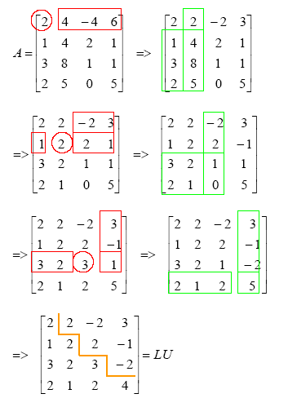
LU decomposition - example

Slide 22
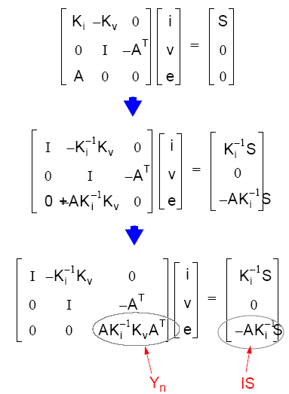

Relation between STA and NA

Slide 23
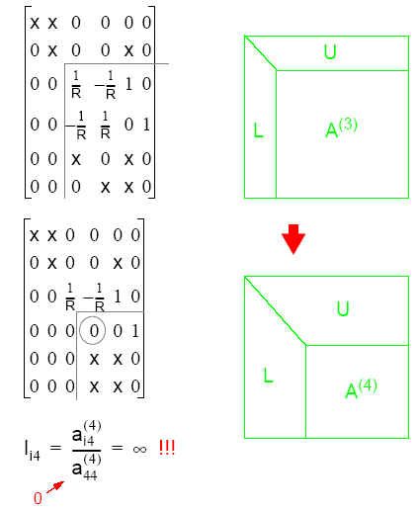
Pivoting for Accuracy:
Example 1:
After two steps of G.E. MNA matrix becomes:

Slide 24
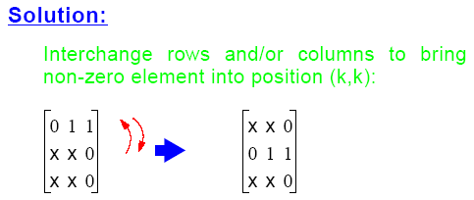
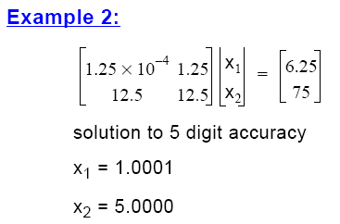
Pivoting for Accuracy:

Slide 25
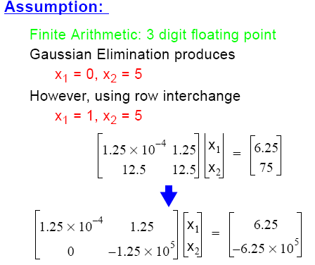
Pivoting for Accuracy:

Slide 26
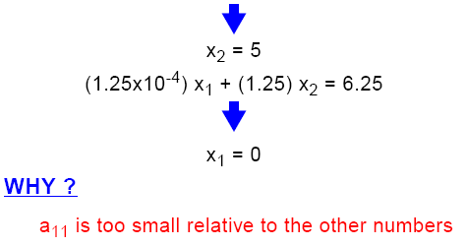
Pivoting for Accuracy:

Slide 27
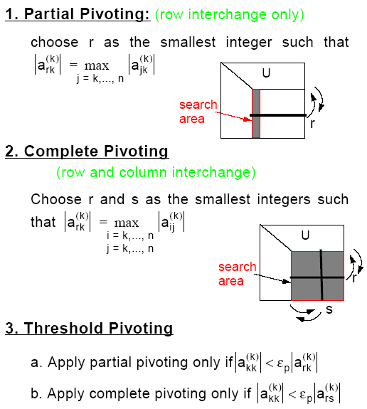
Pivoting Strategies

Slide 28
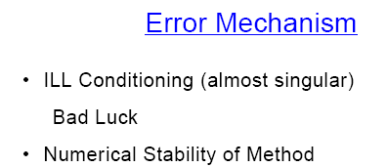

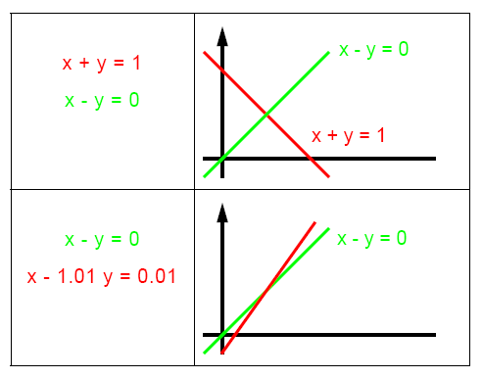
Error Mechanism

Slide 29
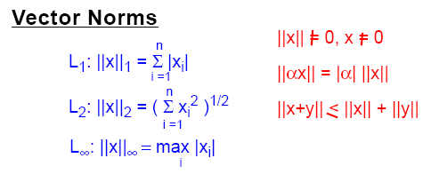
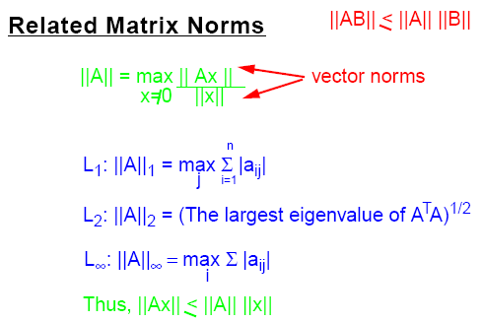
Detecting ILL Conditioning

Slide 30
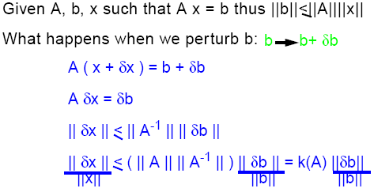
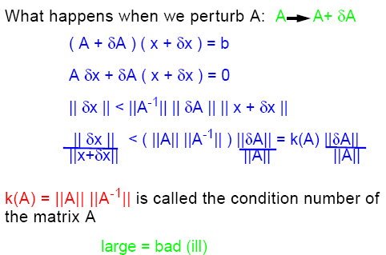
Detecting ILL Conditioning

